Slide 1

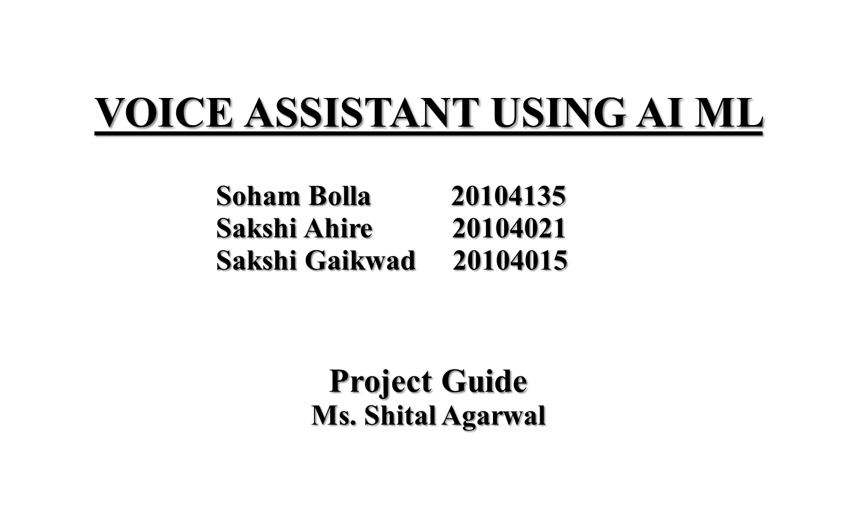


Slide 2

Contents
Introduction
Objectives
Scope
Literature Survey
Proposed System
Algorithm Used
Project Outcome
Block Diagram
Use Case / DFD
Technology Stack

Slide 3

1. Introduction
AI voice assistant, also known as a virtual or digital assistant, is a device that uses voice recognition technology, natural language processing, and Artificial Intelligence (AI)
Virtual assistants, understand natural language voice commands and performs tasks for users
A voice assistant is a digital assistant that uses voice recognition, language processing algorithms
In this project we have developed a static voice assistant using python

Slide 4

2. Objectives
It has been designed to provide a user-friendly interface.
Users can interact with the our assistant through voice commands.
It's brings AI and machine learning together to recognize our voice and do what we ask it
The Objective of AI Virtual assistant in todays world is to replace secretaries and personal Assistant
Requires less consumption of time in writing text.

Slide 5

3. Scope
It opens website and perform task as per user input.
Human and Machines will collaborate seamlessly, allowing machines to learn new words and speech.
Acceptance of the voice command and executes them without any button click.
Modern Voice Assistant can do almost anything you might be able to think of.

Slide 6
4.Literature Survey
Author Name and Year | AI Methods | Results
Rutuja V. Kukade (2018) et al. [4] | Speech to Text Engine, Text to speech Engine, OCR (Optical character recognition) | Implemented model perform tasks by taking human voice commands
Shivangee Kushwah (2019) et al. [12] | CART, XGBoost, SVM and Random Forest | The project’s success with 89% was attributed to the use of a stacked model, which was able to classify the voice as either male or female.
Rijwan Khan (2020) et al. [14] | Artificial Intelligence for Speech Recognition | The project is to create a system that will allow people with limited mobility to grow along with society.

Slide 7

Author Name and Year | AI Methods | Results
Harsh D. Shah (2021) et al.[15] | Automatic Speech Recognition(ASR) | This project proposes a system that allows users to send email using their voice commands and the address book of the person they want to communicate with.
Harivans Pratap Singh (2021) et al. [13] | Speech Recognition using AI, NLP | The success of this project could also encourage developers to create more effective and useful products for people with low vision.

Slide 8

5.Proposed System
User Interface: User interface module will be used by everyone. User interface module will help to interact with user and System vice versa. This module will contain all designing of web applications containing all views of activities
Speech Recognition Module: As the name suggests this module will help in recognizing the voice of the user. We will use windows speech recognition library to recognize speech.
Pattern recognition: It is the process of recognizing patterns by using machine learning algorithms. Pattern recognition can be defined as the classification of data based on knowledge already gained or on statistical information extracted from patterns

Slide 9
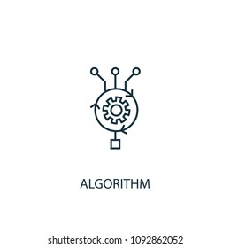
6. Algorithm Used
Natural language processing (NLP): It is the area of artificial intelligence which focuses on the interaction between humans and machines through language through speech and text.
Automatic Speech Recognition(ASR): Voice assistant applications work based on Automatic Speech Recognition (ASR) system. ASR systems record the speech and then break it down into different state, which are later get processed into text.

Slide 10

7. Outcome of Project
Easily scalable to grow with changing system requirement.
Quick, authenticated access to any website via the voice input.
Enterprise wide access to information.
Users can do search anywhere/anytime according to their availability.
One of the main advantages of voice searches is their rapidity

Slide 11
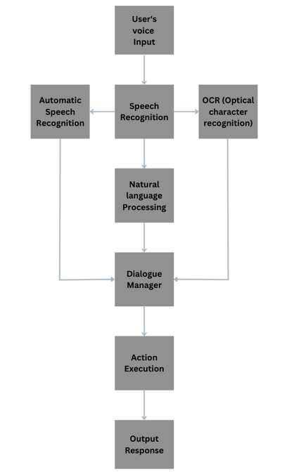
8.Block Diagram/Flow Diagram

Slide 12
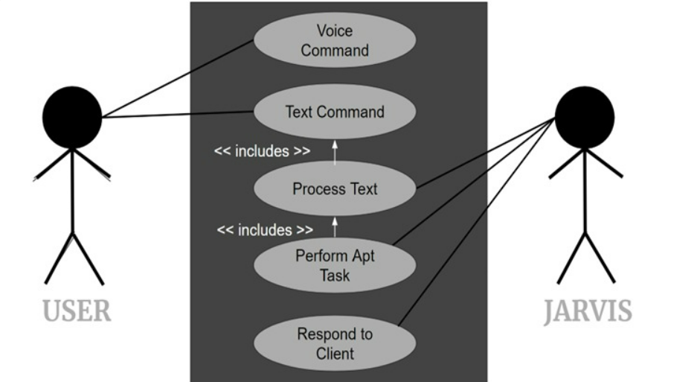
9.Use Case Diagram

Slide 13

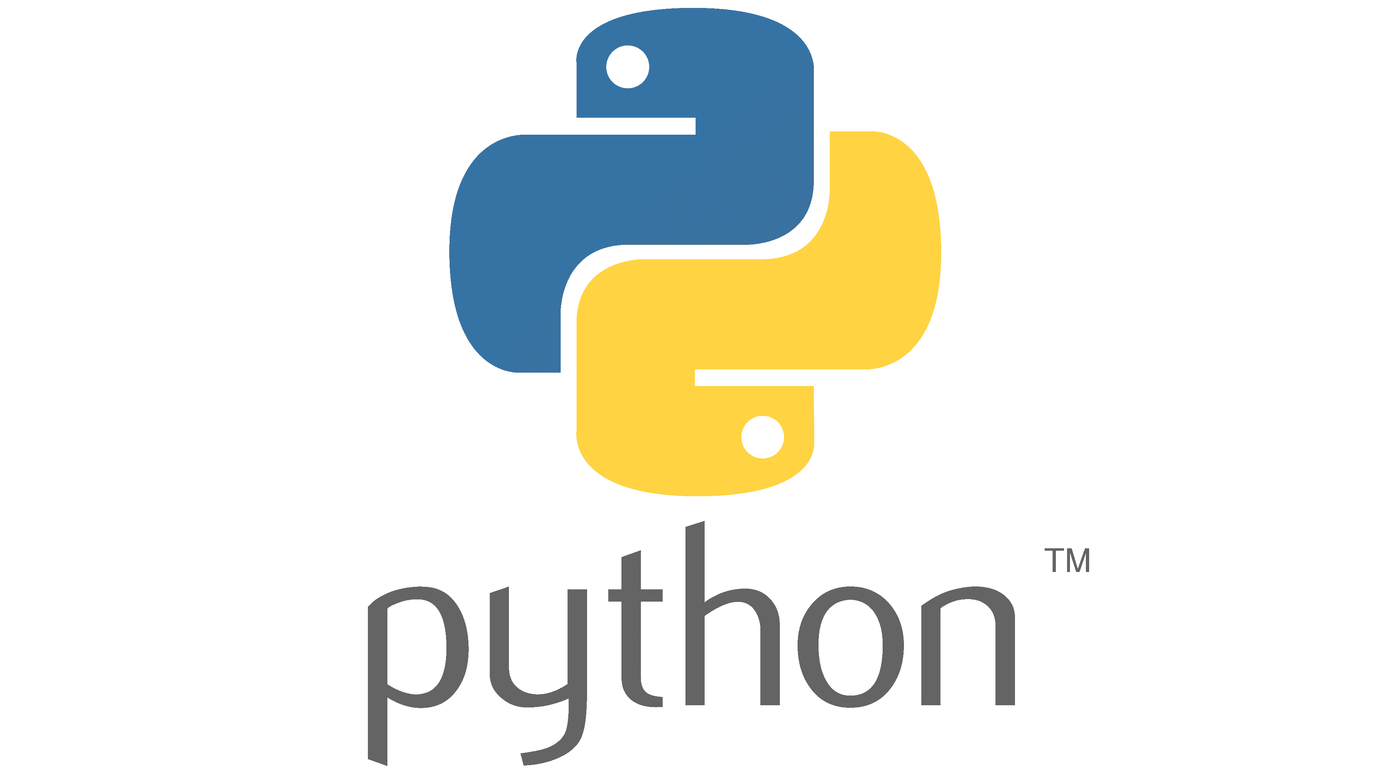
10. Technology Stack
GUI: Python (Visual Studio IDE)
Backend: Python Backend.
OS: Windows

Slide 14
Thank you!!!

